Slide 1
Unsupervised Pre-training of Graph Neural Networks
Ziniu Hu
2/6/2019

Slide 2
A hierarchy of tasks
Local Structure:
Graph Reconstruction (Masked Link Prediction)
Global Structure:
Ranking Estimation of Betweenness, PageRank …
Graph-level Structure:
Graph Edit Distance
Subgraph Distance in the whole graph

Slide 3
Graph Reconstruction (Masked Link Prediction)
Mask half of the link in a graph, denoted as masked link
In each batch:
pick one pair that still have link in graph (True Label)
one pair that are have masked link (True Label)
x pair that do not have link (negative sampling)
Use cosine similarity as objective function to pre-train the model

Slide 4
Ranking Estimation of Betweenness, PageRank…
Calculate important properties for a given graph (such as pagerank)
In each batch:
Randomly pick two nodes, get a property rank gap (+1/-1), use pair-wise ranking loss as objective to pre-train the model.

Slide 5
Graph Edit Distance
Calculate GED for arbitrary two graphs
In each batch:
Randomly pick two graphs, calculate graph-level representation similarity to approximate GED.

Slide 6

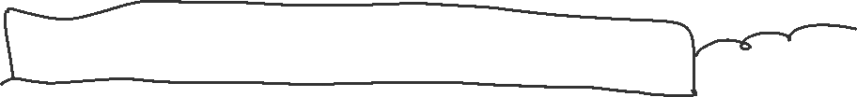
Input Data
('powerlaw_cluster_graph')
('barabasi_albert_graph')
('fast_gnp_random_graph')
Graph
Target Graph (Semi-supervised Setting)
Pre-given Graph Set, such as randomly generated graph (Purely Unsupervised Setting)
Feature
Only Degree:
use to encode degree
Learned Embedding:
Learn e2e for each graph. For target graph, first fix the other parameters, and use pre-train tasks to finetune the embedding
Meaningful Features:
Can only use target graph as pre-training

Slide 7
Node Classification (Cora Dataset)
GCN(3-layer) | No Pretrain | Random Generated Graph | Target Graph | Random Generated Graph + Target Graph (Subsequent)
Reconstruction | 0.753 ± (0.010) | 0.761 ± (0.009) | 0.770 ± (0.011) | 0.774 ± (0.014)
Closeness | 0.753 ± (0.010) | 0.765 ± (0.012) | 0.762 ± (0.008) | 0.764 ± (0.009)
Rec + Clos | 0.753 ± (0.010) | 0.768 ± (0.013) | 0.770 ± (0.012) | 0.776 ± (0.015)
Edit Distance | 0.753 ± (0.010) | / | / | /
GCN(4-layer) | No Pretrain | Random Generated Graph | Target Graph | Random Generated Graph + Target Graph (Subsequent)
Reconstruction | 0.806 ± (0.016) | 0.814 ± (0.014) | 0.821 ± (0.016) | 0.825 ± (0.005)
Betweenness | 0.806 ± (0.016) | 0.819 ± (0.011) | 0.815 ± (0.009) | 0.819 ± (0.012)
Edit Distance | 0.806 ± (0.016) | / | / | /

Slide 8
Different Pre-training Tasks
Tasks | Node Classification (Cora) | Link Classification (MovieLens 1M) | Graph Classfication (NCI 309)
Reconstruction | 2.8% | 3.4% | /
Closeness | 1.6% | 2.5% | /
Edit Distance | / | / | 5.8%

Slide 9
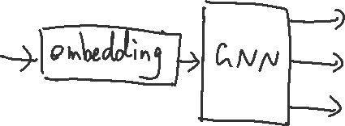

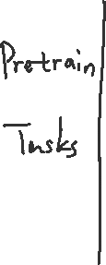
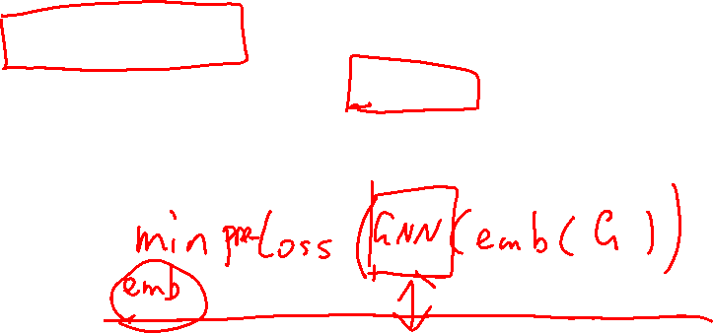


Adapt Embedding
Only Test on Reconstruction + Node classification setting.
Node2Vec: 0.695; E2e: 0.814;
Ours (Fix): 0.826; Ours Finetune: 0.841.

Slide 10
TODO
Combine the three methods together (for ranking part, test multiple objective and find the best)
Test on more datasets
Test the estimated embedding feature input
Test the meaningful input setting, and in that case whether randomly generated graph can be used

Slide 11
Long-tail node representation learning using Graph Neural Networks
Ziniu Hu
2/6/2019

Slide 12
Long-tail node feature estimation
Explicit features, such as user profile, interests, are really important to deal with cold-start problems.
However, not every users will provide sufficient user profile information.
Whether we can leverage its limited interaction history (graph links) to estimate their profile representation (first-layer input)?

